Slide 1
Masks and Celebrations in Mexico:
The Art of Mascarero Felipe Horta
UNM Latin American & Iberian Institute

Slide 2
This presentation will cover…
Masks in Mexico – History & Purpose
Masks in Mexico – Materials & Roles
Masks and Celebrations – La Pastorela
The Story of La Pastorela
La Pastorela and the Americas
La Pastorela and Mexican Masks
La Pastorela Today
La Pastorela, the Devil and los Negritos
Mascareros - Mask Makers
Masks and maskmaking – Felipe Horta

Slide 3
Masks in Mexico – History & Purpose
Masks have been created and used in Mexico since 3000 B.C.
Masks were used as an important part of ritual dance expressing the beliefs and religion of the community.
Masks were made by farmers, carpenters and other laborers who passed down their skills but often did not identify themselves in their work.

Slide 4
Masks in Mexico – Materials & Roles
Masks can be made from wood, leather, papier-mâché, wax and metal, embellished with horse and goat hair, straw, ribbons, mirrors, yarn, braided straw, horn and animal teeth.
Among mask themes are animals such as jaguars and deer, religious and historical figures and ethnic types.

Slide 5
Masks and Celebrations - La Pastorela
Many important celebrations still use these masks today.
One way that these masks are used in Mexico is in pastorelas. A pastorela is a play or theatrical performance.
La Pastorela is a play/performance specific to Christmas. It is the story of the shepherds who travelled to Bethlehem to find the baby Jesus.

Slide 6
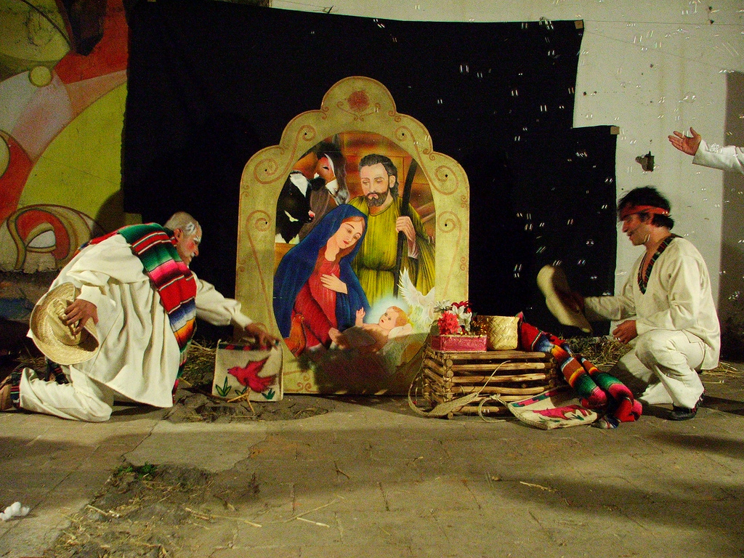
La Pastorela
La cola del diablo (Pastorela), performed by Grupo Teatro de la Calle Lumbrales.
Toluca, Mexico, 2006.
Image provided courtesy of Flickr user Gato Azul,.
Retrieved 11/7/11 from http://www.flickr.com/photos/gatoazul/327401627/

Slide 7
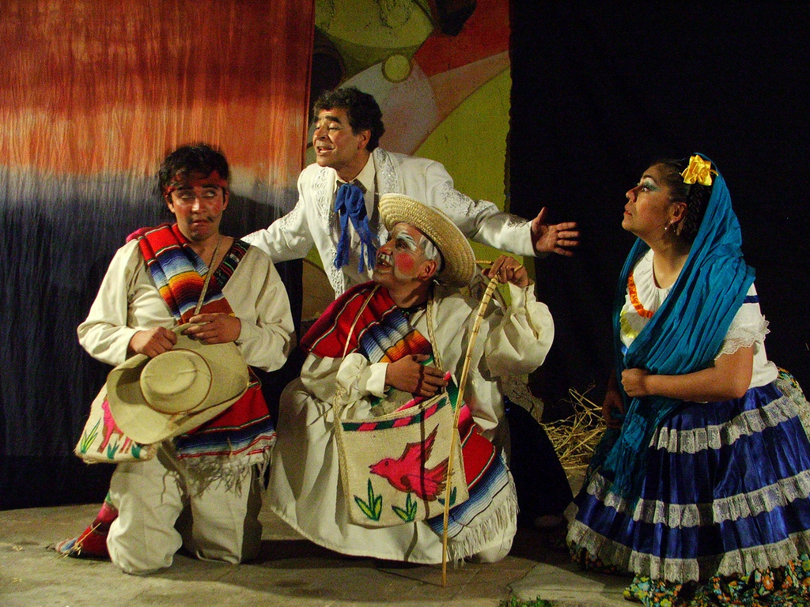
La Pastorela
La cola del diablo (Pastorela), performed by Grupo Teatro de la Calle Lumbrales.
Toluca, Mexico, 2006.
Image provided courtesy of Flickr user Gato Azul,.
Retrieved 11/7/11 from http://www.flickr.com/photos/gatoazul/327401627/

Slide 8
The Story of La Pastorela
La Pastorela is over 800 years old!! It originated in the 1200s in Spain.
It was used as a way to tell the Christmas story. In the middle ages, the church service, or mass, was done in Latin, a language many did not understand. The play was something everyone understood
In the 1500s the Church banned the plays, but that didn’t stop them from coming to the Americas. . .

Slide 9
La Pastorela and the Americas
In the 1500s Spain began exploring the Americas.
The Azteca lived in what is today Mexico—one of the areas that Spain explored and eventually colonized.
Many Spanish priests and friars came to Mexico to share Christianity with the Azteca.
The Azteca did not speak Spanish, so the priests needed a way to share the story of Jesus with the Azteca. They used the play La Pastorela.
When the Spanish began to colonize what is now New Mexico, they used La Pastorela again, this time with the Pueblo Indians. That is how La Pastorela came from Spain first to Mexico and then to New Mexico.

Slide 10
La Pastorela and Mexican Masks
La Pastorela changed a lot when it came from Spain to Mexico, and continues to change even today.
One of the biggest differences is the use of masks in the re-enactment of the Shepherds story.
The masks used to portray the different characters of the story are one of the most important parts of La Pastorela in Mexico.

Slide 11
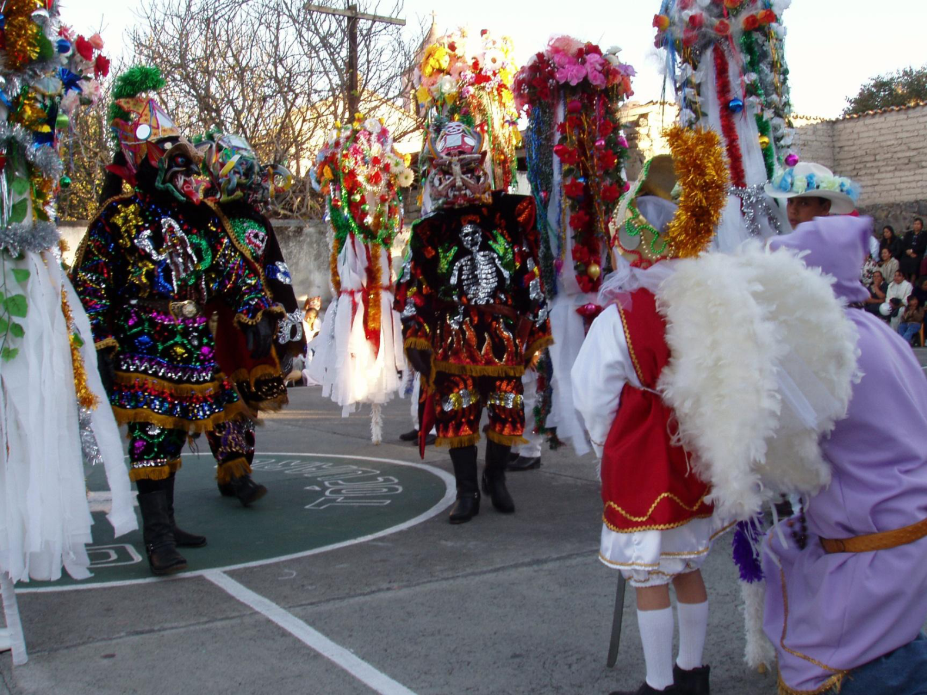
Pastorela danzas in Michoacán
Image provided courtesy of Pavel Schlossberg.

Slide 12
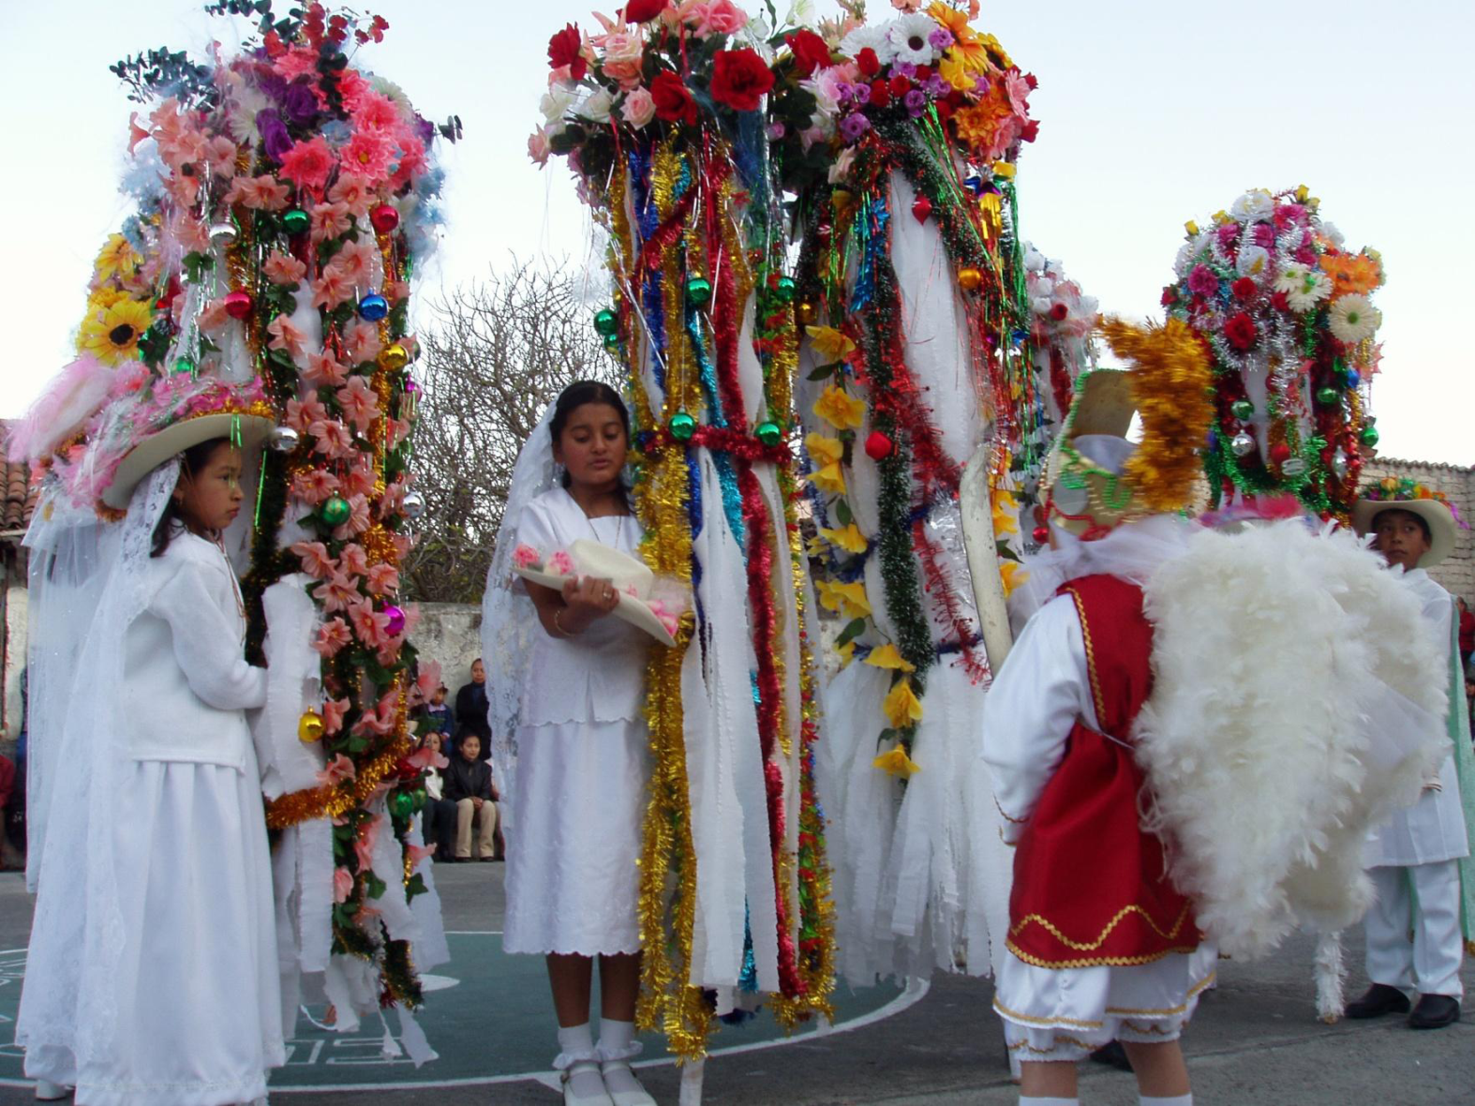
Pastorela danzas in Michoacán
Image provided courtesy of Pavel Schlossberg.

Slide 13
La Pastorela Today
While La Pastorela still tells the story of the shepherds trying to find baby Jesus, it has evolved a great deal since the 1200s.
It is often re-enacted outside in a town square and through the nearby streets. It will go on for days, sometimes an entire week.
The devil and los negritos are important parts of the play today.

Slide 14
La Pastorela, the Devil and los Negritos
The devil does all sorts of things to try and keep the shepherds from reaching baby Jesus.
Los negritos represent the everyday person who struggles with different things that keep him or her from always doing the right thing. Often times a famous person’s persona is used as a negrito costume—for example, superman or Vicente Fox (Mexican president). The point in using them is to show that even famous people or superheroes aren’t perfect; they have their struggles, too.
An important part of both of these costumes are the masks that the devil and los negritos wear.

Slide 15
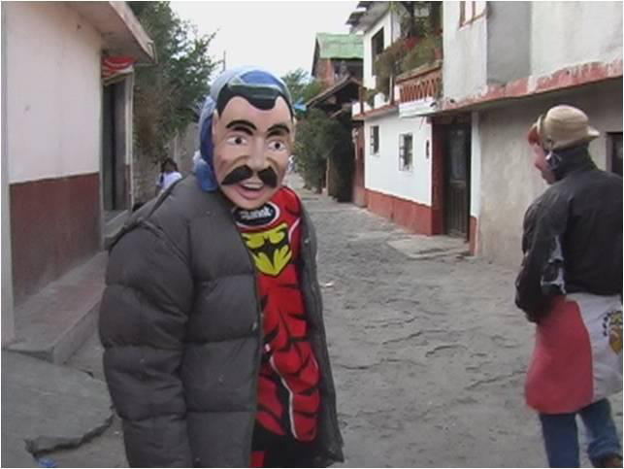
Pastorela danzas in Michoacán
Image provided courtesy of Pavel Schlossberg.

Slide 16
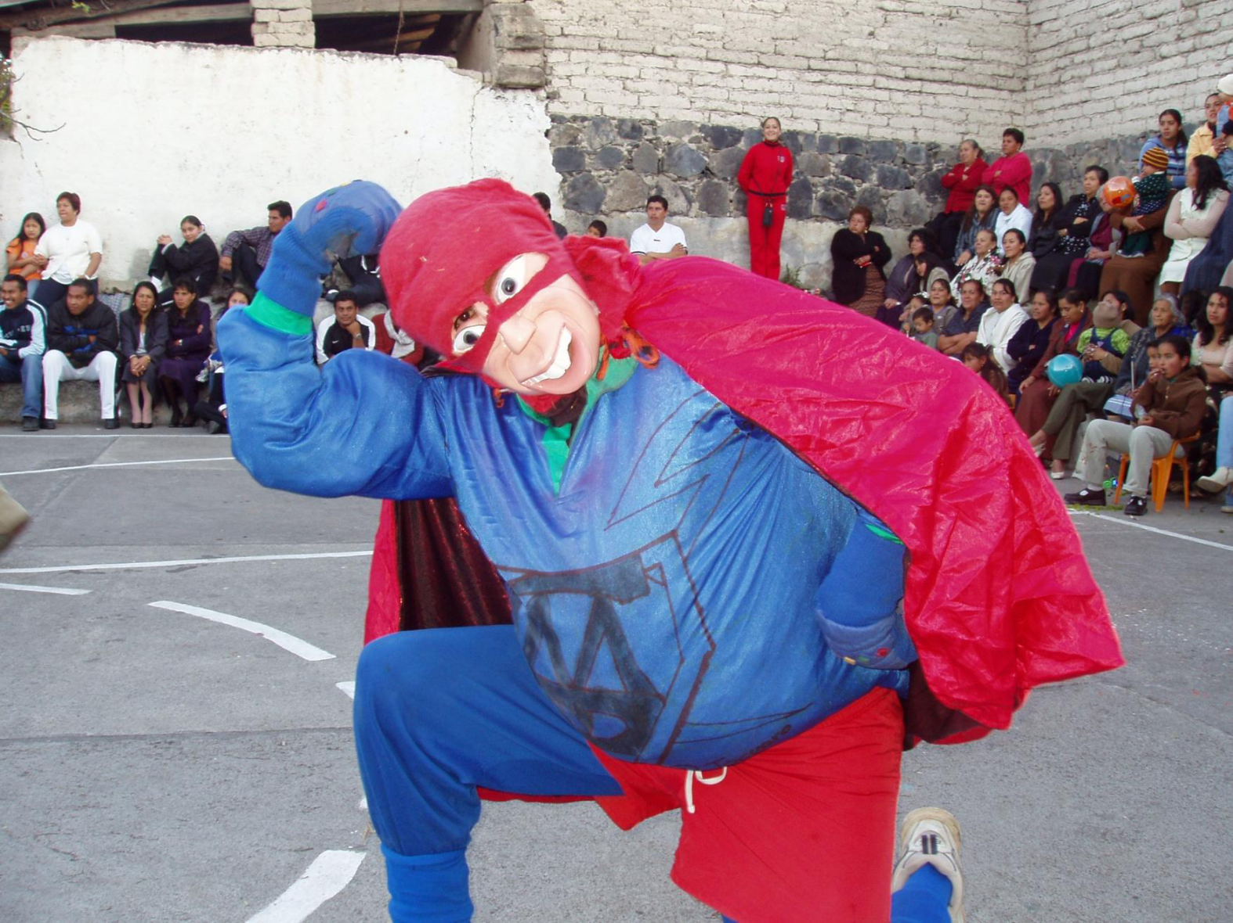
Pastorela danzas in Michoacán
Image provided courtesy of Pavel Schlossberg.

Slide 17
Mascareros - Mask Makers
The mask makers are famous for the work they do. In Spanish, mask makers are called mascareros.
For La Pastorela, the mascareros have to be very creative. They create the masks for the devils and for the negritos.
One famous mascarero is Felipe Horta

Slide 18
Masks and maskmaking – Felipe Horta
Felipe Horta…
  Is an internationally-renowned mascarero from Tocuaro, Michoacán.
  Has dedicated himself since the age of 12 to producing masks for La Pastorela celebrations.
  Has introduced new, contemporary maskmaking techniques as part of the traditional celebrations for La Pastorela.
  Incorporates local, indigenous culture as well as global, popular culture.

Slide 19
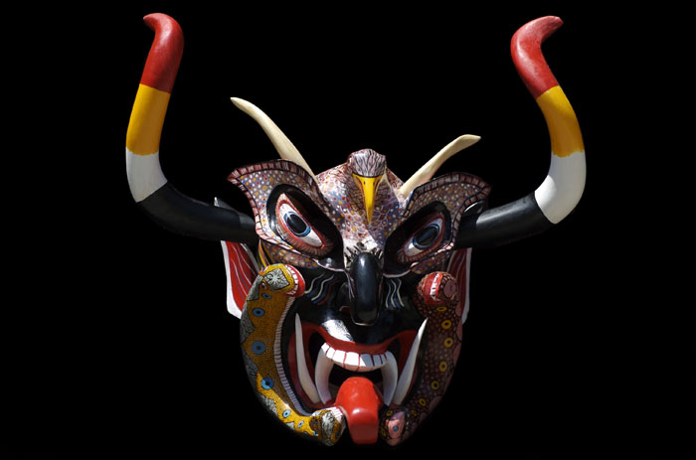
Máscara de Diablo Negro
by Felipe Horta
Mask by Felipe Horta.

Slide 20
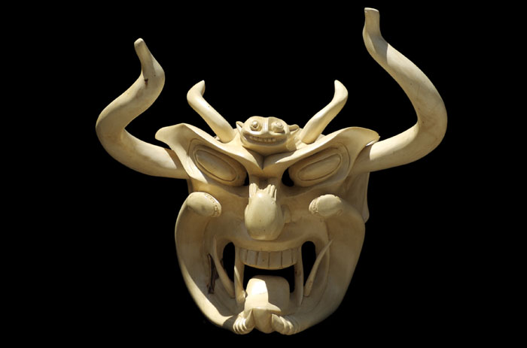
Máscara de Diablo Negro
Mask by Felipe Horta.

Slide 21
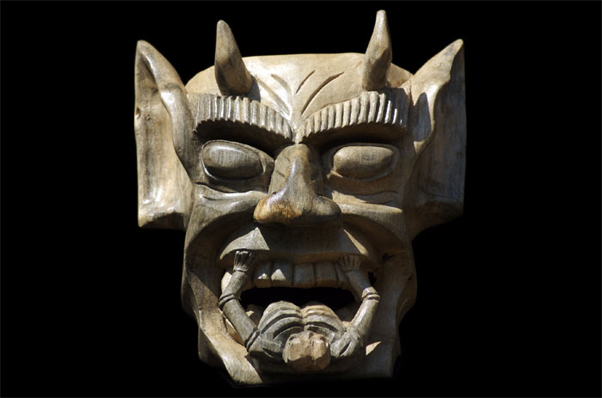
Máscara de Diablo Negro
Mask by Felipe Horta.

Slide 22
Additional Resources
  Felipe Horta’s personal website
  Traditions of Mexico
    An online educational project of the Houston Institute for Culture.
  Mexican Folk Art
    An online content guide produced by the Phoebe A. Hearst Museum of Anthropology at the University of California.
  Masks of Mexico
    An online guide for teachers based in the museum exhibition “Masks of Mexico.”
  Negritos Masked Drama
    A podcast produced by the Arizona State Museum that discusses the Negrito masks of Uruapan, Michoacán and how they represent many of the roles played by Africans and their descendants in colonial Mexican society.

